Slide 1
Theatre Buildings and Structures
By: Victoria Dean, Melisa Ozcolak, Mike Terry

Slide 2
Amphitheatre~
added a highly decorative stage building; incorporated different levels of columns, projections, pediments, and statues
triumphal arch-single, double, or triple entrance-had no practical function other than describe in sculpture and inscription significant events (ex. military victories)
width of Roman walls vary from 18 cm to 6 m thick
marble and fine stone blocks rarely used as it was too expensive; bricks and stones could be arranged in various ways

Slide 3
Colosseum~
The Colosseum was built in 70A.D.
site of celebrations, sporting events, and bloodshed
host to about 3.9 million visitors each year
in its active prime for about four centuries
It took about a decade to construct and lasted centuries to this day
One of the most popular attractions to date

Slide 4
the column was an architectural invention which allowed for the support of ceilings without the use of solid walls
it increased the space which could be spanned by a ceiling, allowed the entrance of light and offered an alternative aesthetic to building exteriors
columns could also be incorporated within walls or be freestanding
Columns~

Slide 5
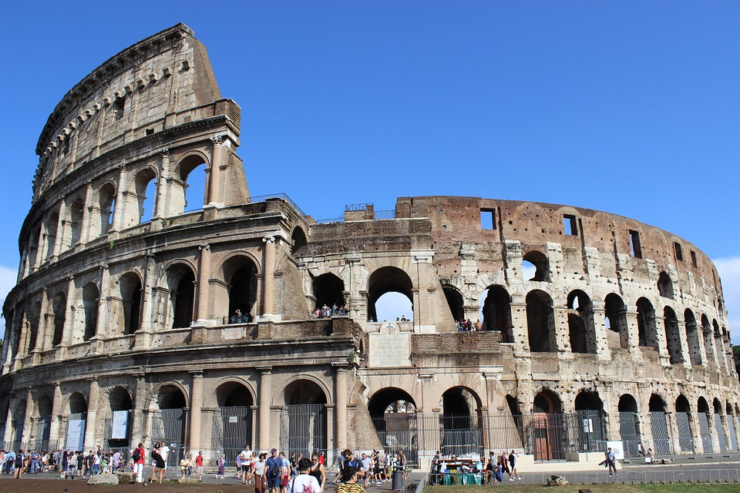
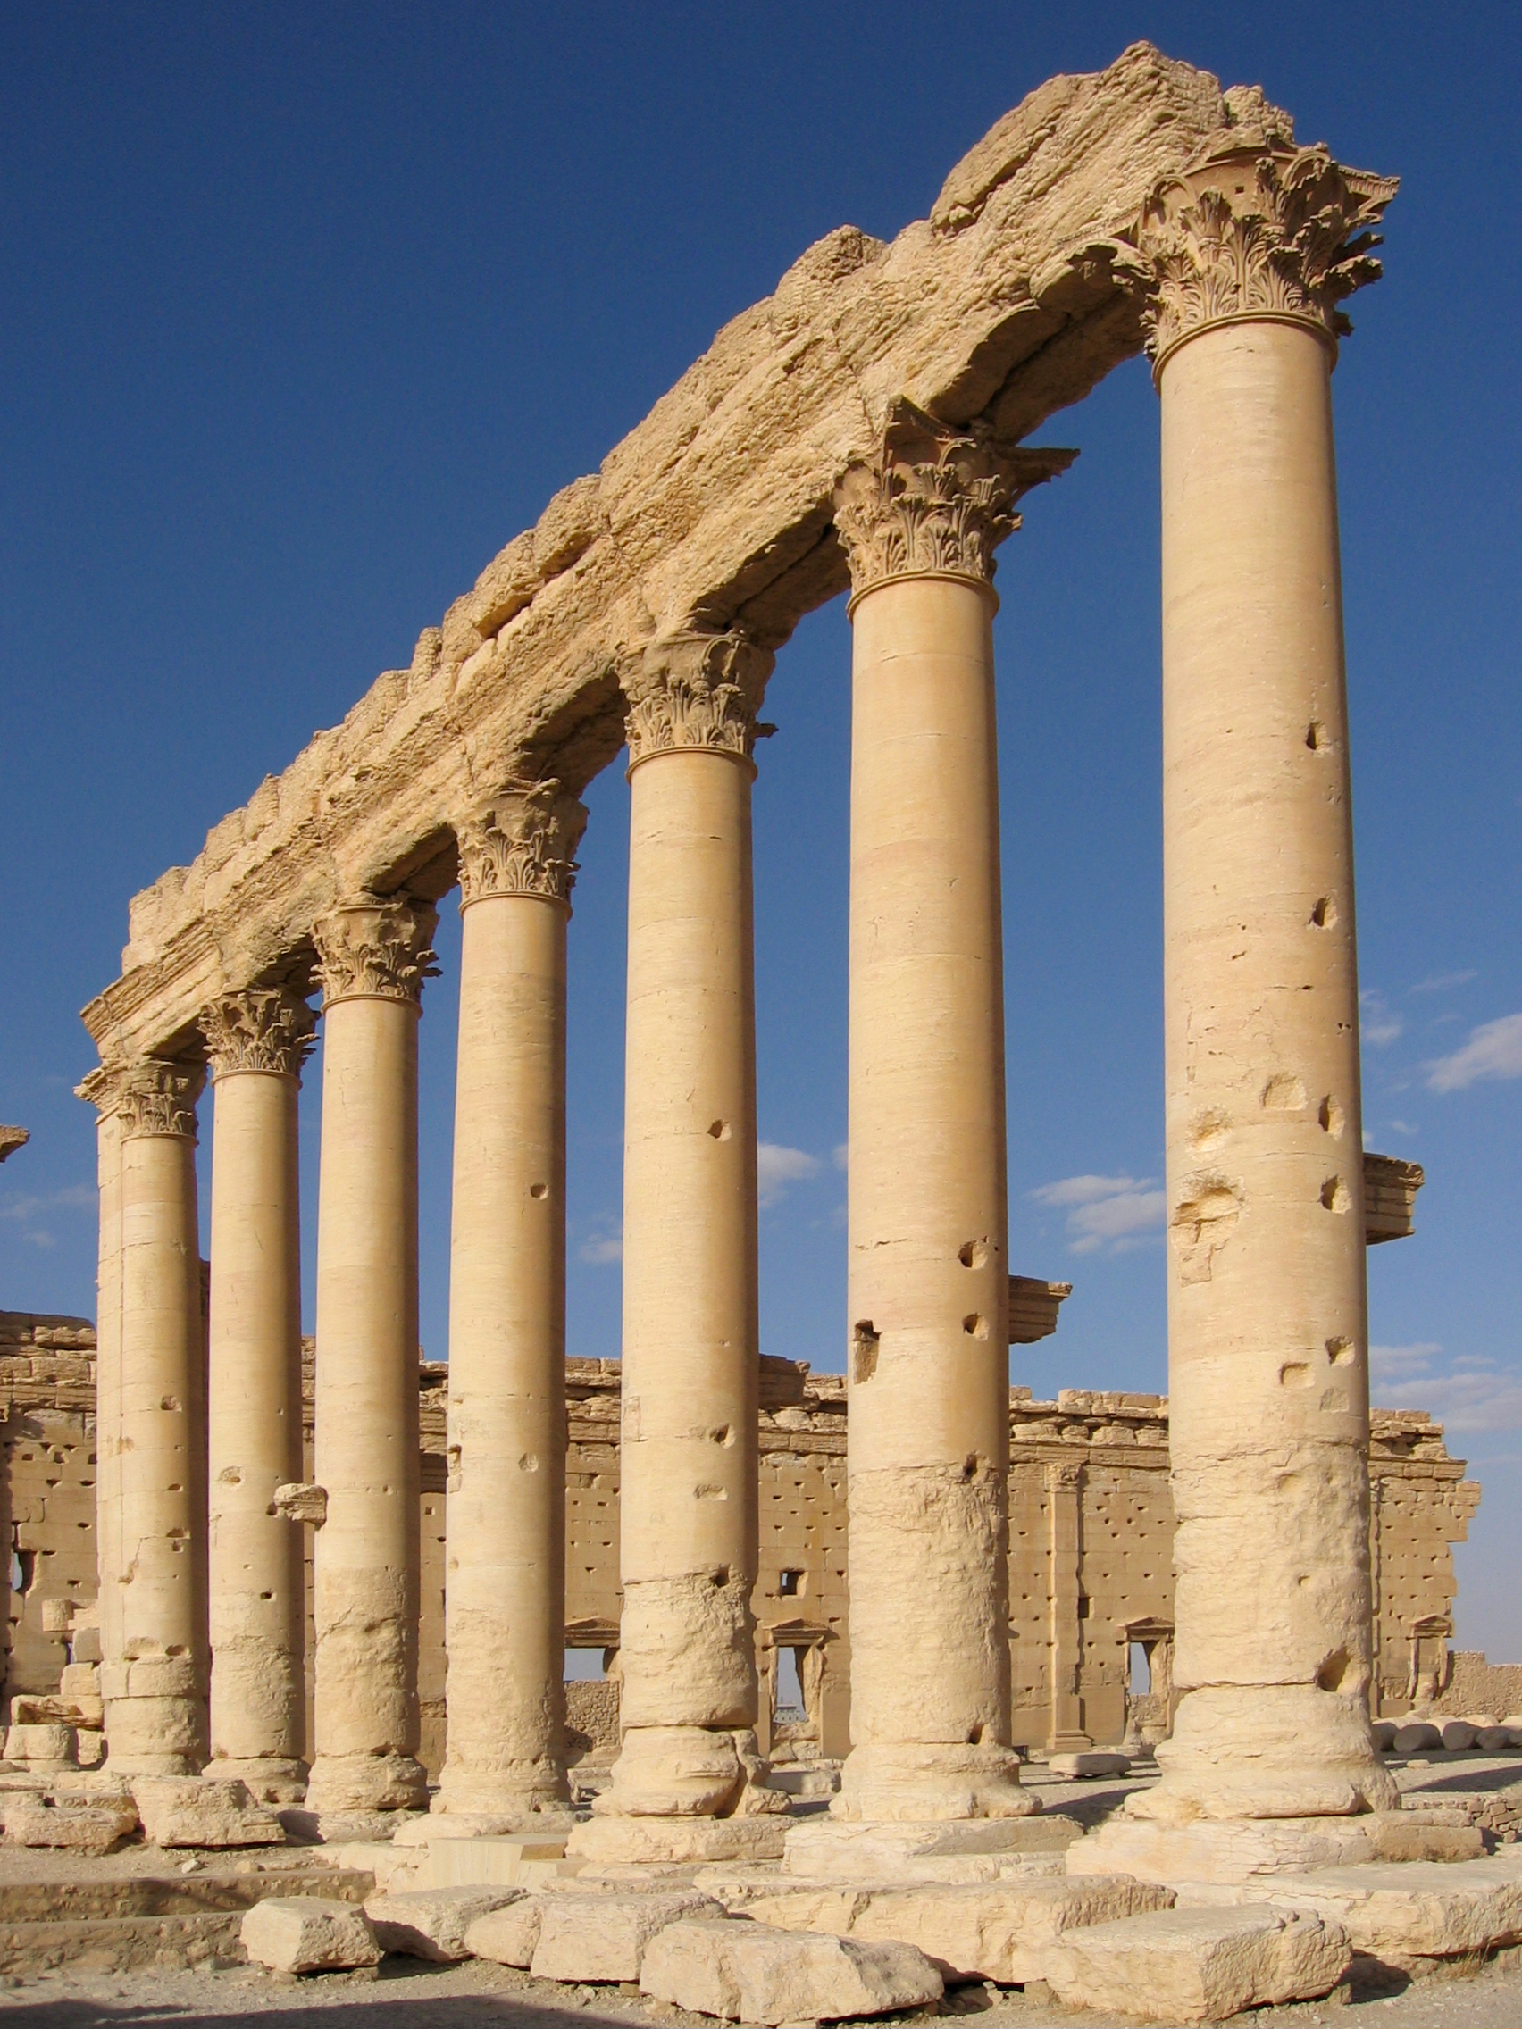
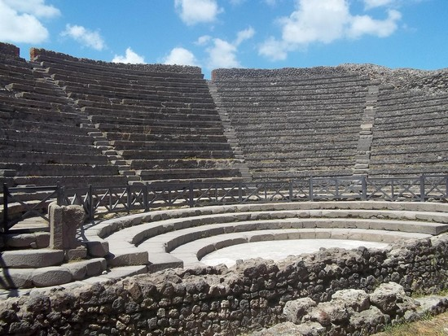
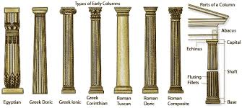
Pictures:
The End

