Slide 1
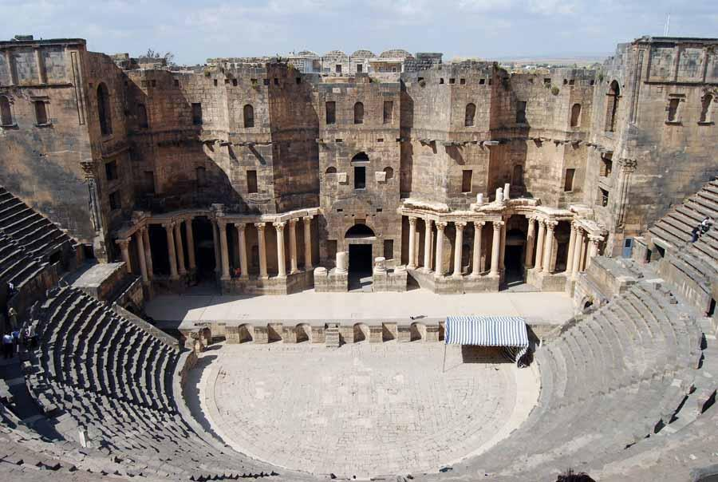
Roman Origins and Influences
By: Ariaz Madani Brandon Koskie, Jenny Stauffer, and Alex White

Slide 2
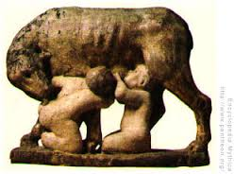
Romulus or Roma
-Romulus and Remus founded Rome. Then Romulus killed Remus and named the city after himself.
-Roma, and other survivors of the fall of Troy, traveled to the banks of Tiber. The trojans eventually became Romans.

Slide 3
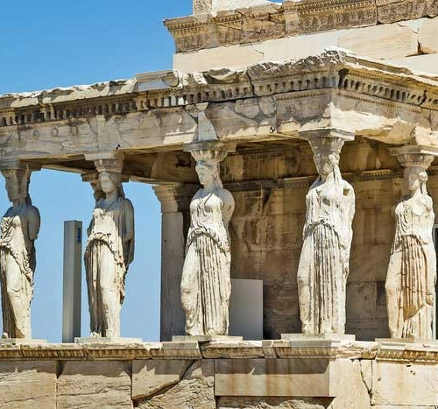
Outside influence
-Roman culture borrowed religion, architecture, and literacy from Greece.
-Etruscan taught them trade.
-Romans good at borrowing and improving skills or concepts.

Slide 4
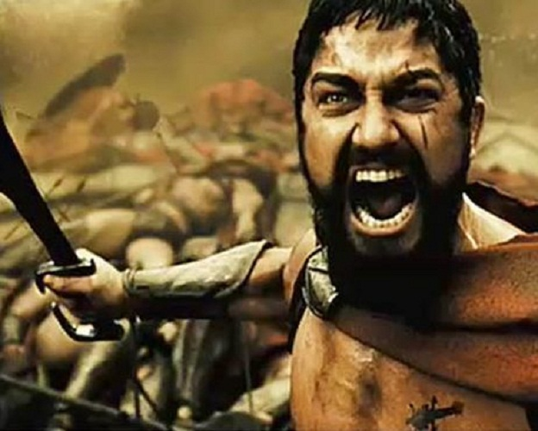
War and Expansion
-War with the Northern African city Carthage gave them dominance of Mediterranean.
-Slave trade and corruption was rampant.
-It was the biggest empire.

Slide 5
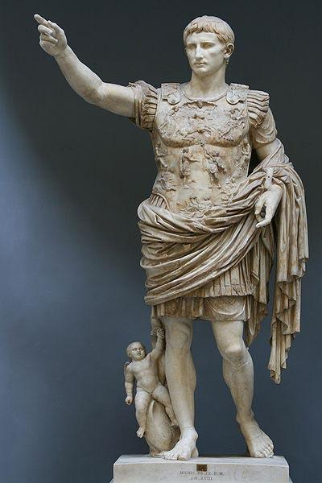
Some Important figures
-Julius Caesar is declared dictator and is a brilliant general, but is soon stabbed to death.
-Octavian defeated the Brutus and Cassius at the Battle of Phillippi.
-Tiberius and Gaius lead a movement to create political reforms and land reforms.
-Emperor Augustus was the founder of the Roman Empire.

Slide 6
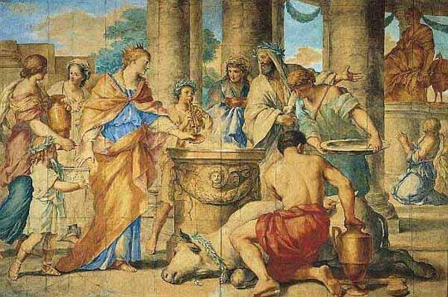
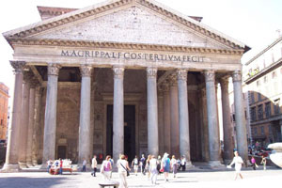
Religious influences
The Romans had a religion that was based on a mixture of fragmented rituals, taboos, superstitions, traditions, etc
Most Roman gods and goddesses were a blend of several religious influences. Many were introduced via the Greek colonies and through the roots of the Etruscans or Latin tribes.
Most forms of religious activity required some kind of sacrifice. And prayer could be a confusing matter due to some gods having multiple names or their sex even being unknown.

Slide 7
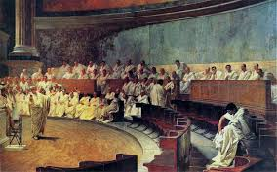
Law
The first law code in Roman history was the Law of the Twelve Tables, the precursor to the development of Roman law. Roman law developed the division between public law, in which the state is directly involved, such as with issues of treason and taxation, and private law, concerned with disputes between people, such as over contracts.
Roman law also influenced the development of private international law. Romans had indictments and jury trials, similar to today's practices. Many defense techniques currently employed can also be traced back to Roman procedures. The idea of “innocent until proven guilty,” which underlies the United States ' criminal justice system, also came from ancient Roman ideas. Also, the purpose of written law as a way to protect individuals from one another and from the power of the state is an inherently Roman idea.

Slide 8
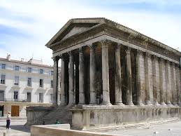
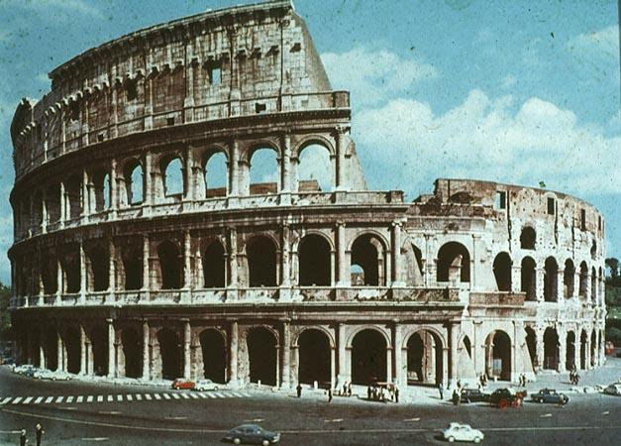
Structures
Roman influences in modern society can also be seen in infrastructure systems. Roman roads used three levels of substructure beneath the paving stones, and a prescribed angle for the uplift of the center of the road, allowing rainwater to drain off. They used numbered signposts every Roman mile, which indicated such things as the distance to the next town and which construction battalion had built the road. They also had extensive networks of underground lead pipe, supplying clean water. They utilized the concepts of parks, public libraries, and plazas.

