Slide 1
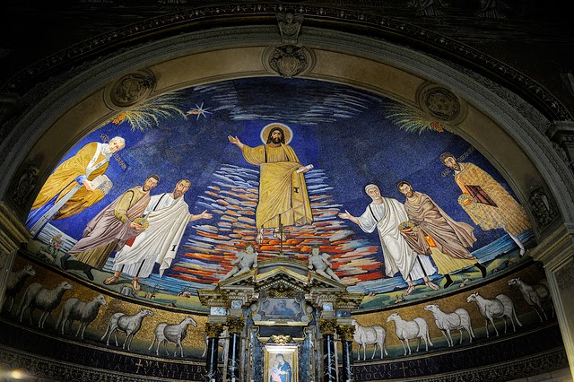
Forms of Roman Theatre
By Madison Sayler-Tait, Michael Ortiz and Theki Chang

Slide 2
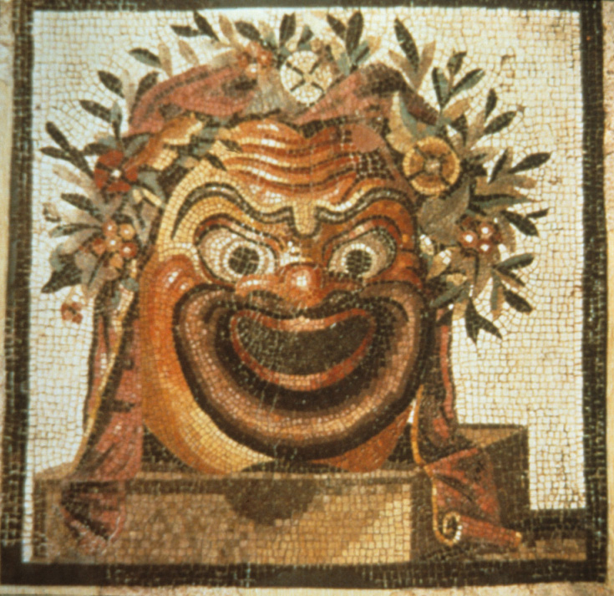
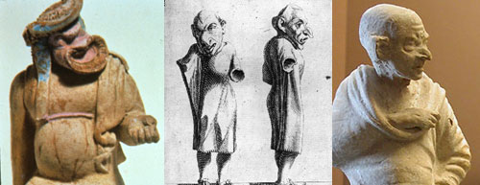
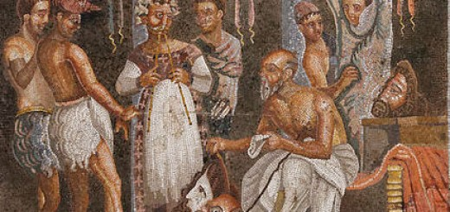
Atellan Farce
Earliest form of farce in Italy
Crude humour style
Uses many masks/disguises
Focus on improv

Slide 3
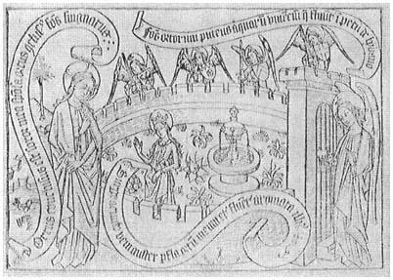
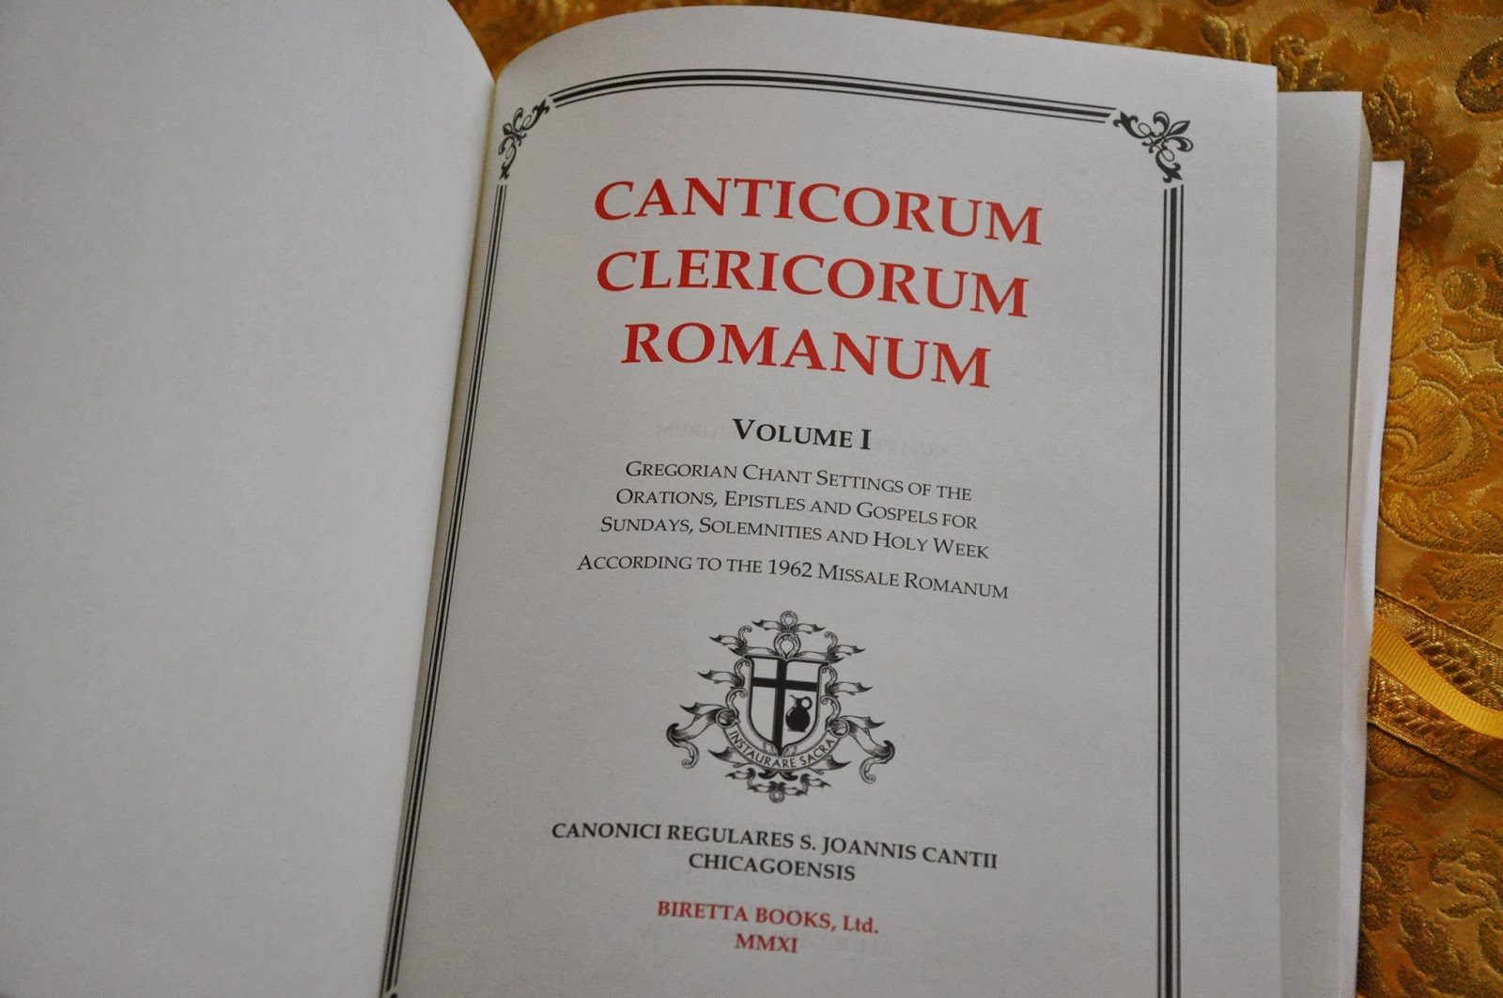
Canticum
Part of a Roman drama
Sung, chanted, or declaimed
Accompanied by music
A long passage that is lyrical or recitative
Over ⅔ of Plautus’ plays are cantica

Slide 4
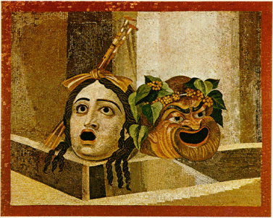
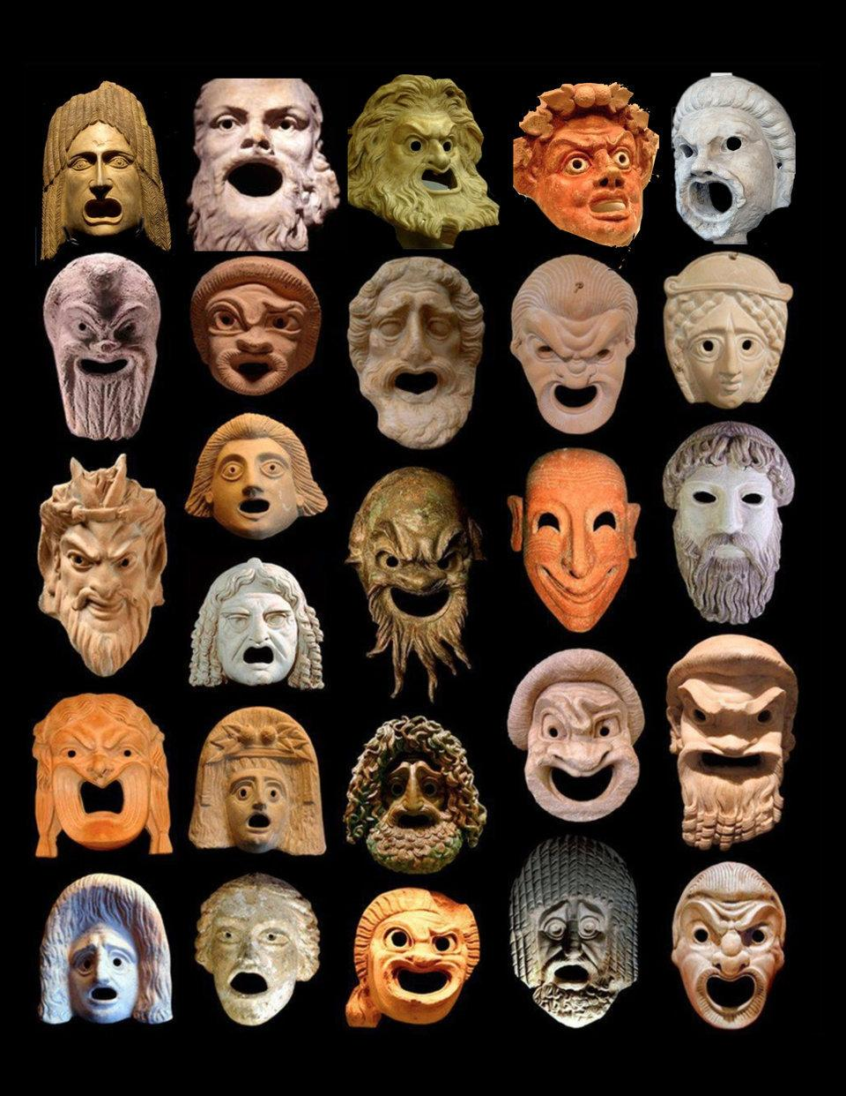
Pantomime
A solo dance
Also had music
Included a chorus
Masks and storytelling
Both mythology and historical stories told

Slide 5
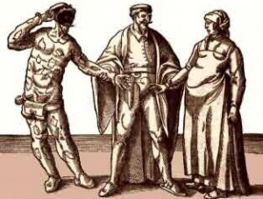
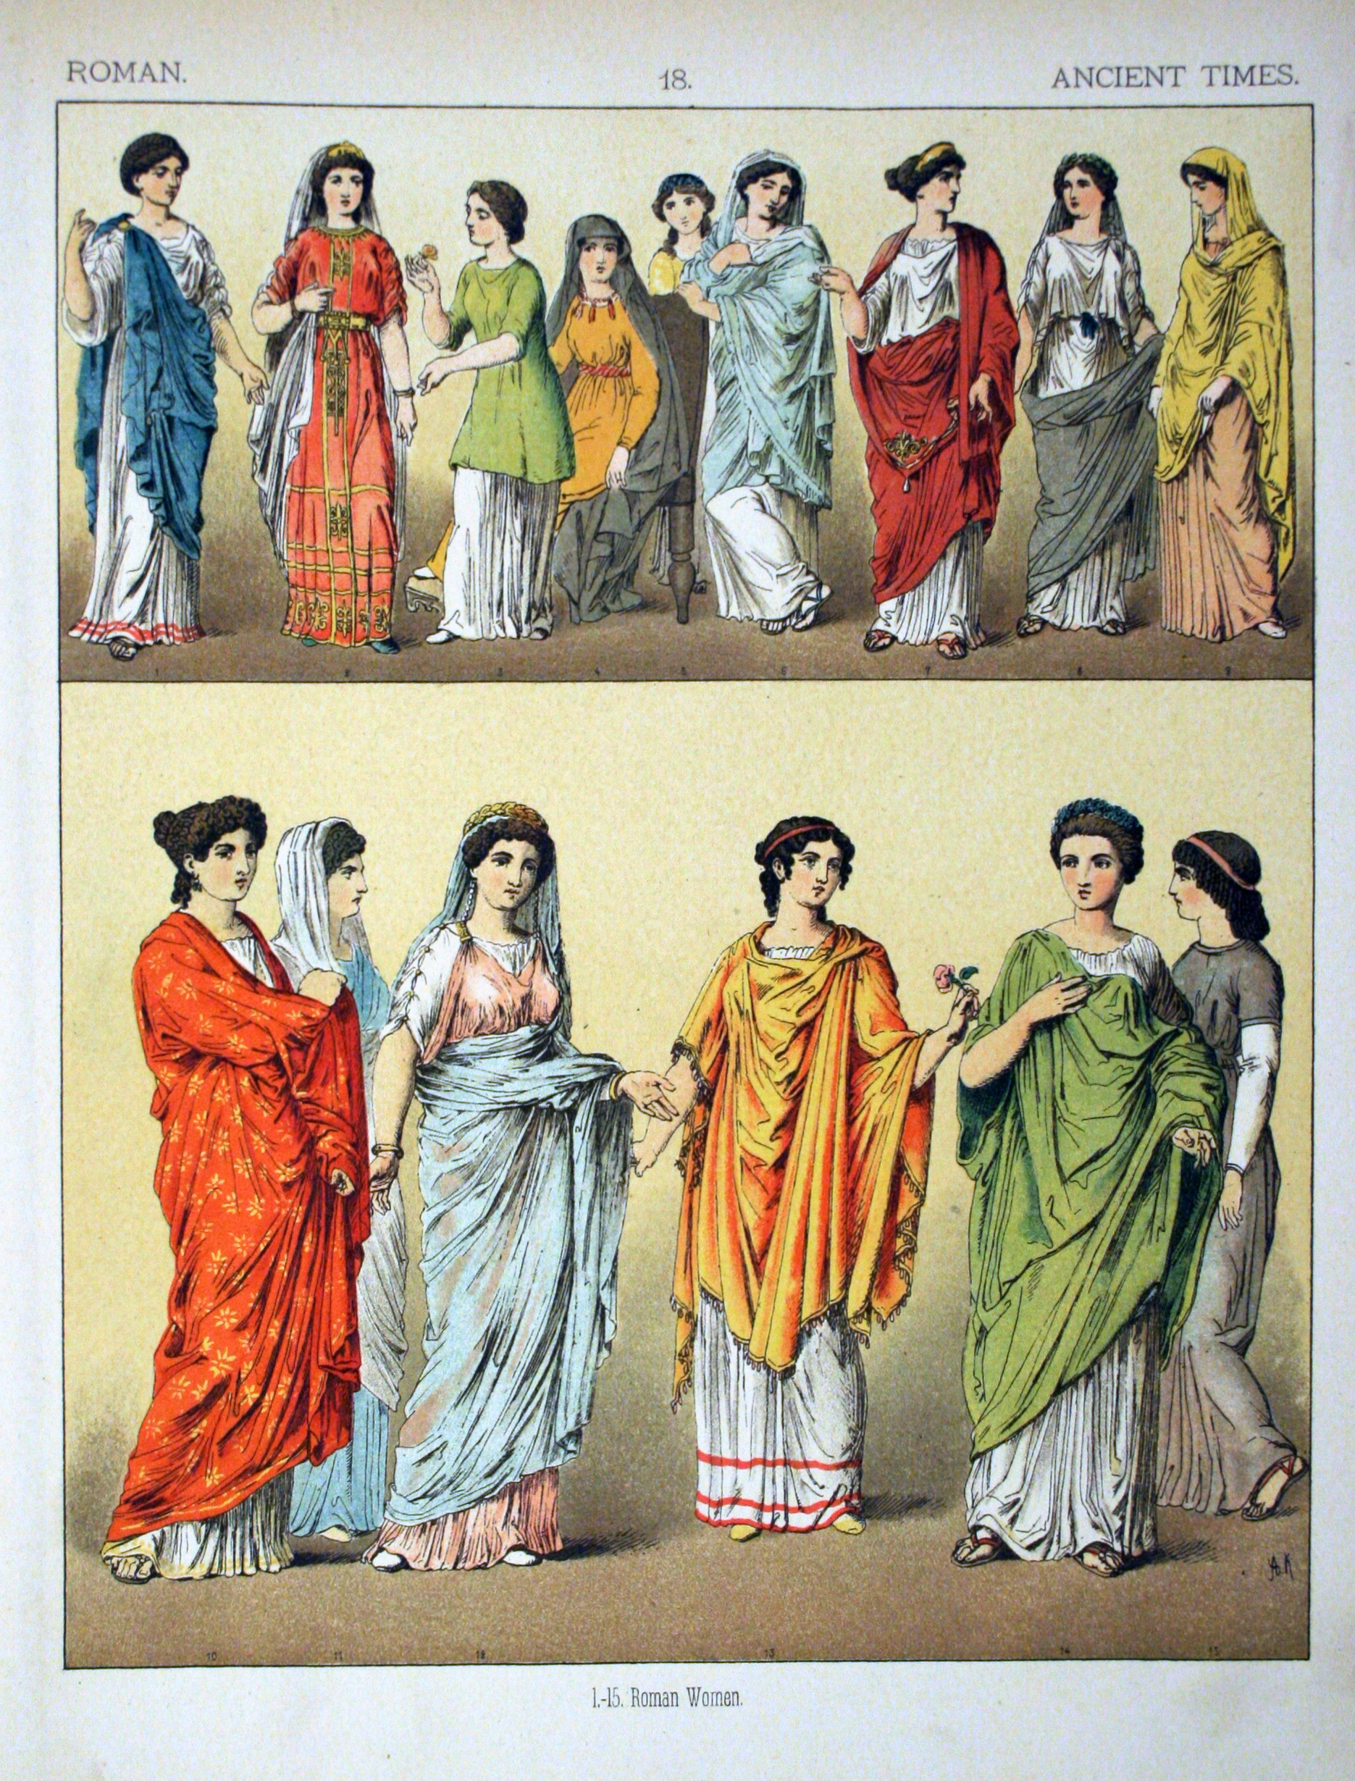
Mime
Usually short
Satirical
No masks
Women were included
Realistic violence and sex
Church disliked Mime

Slide 6
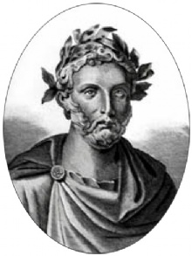
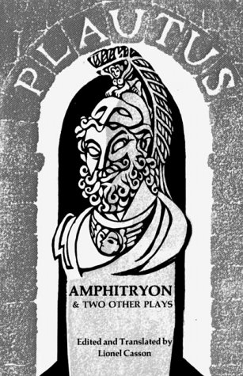
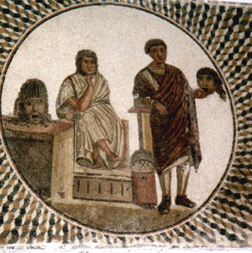
Titus Maccius Plautus - playwright
Very popular form of comedy
Witty jokes
Stychomythia - dialog with short lines
Also has songs

Slide 7
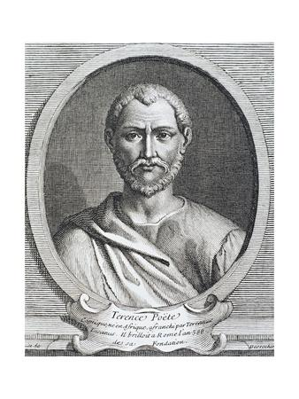
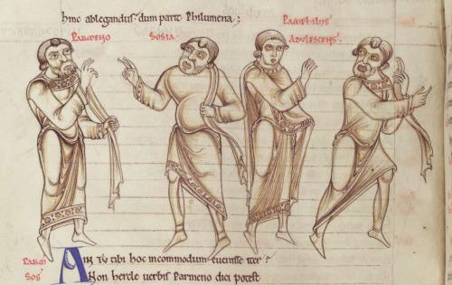
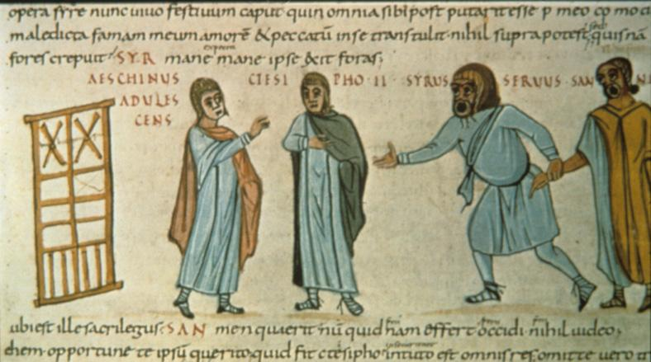
Publius Terenius Afer - playwright
Complex plots
Contrasts in human behavior
Elegant language
Less boisterous and episodic
No songs

Slide 8
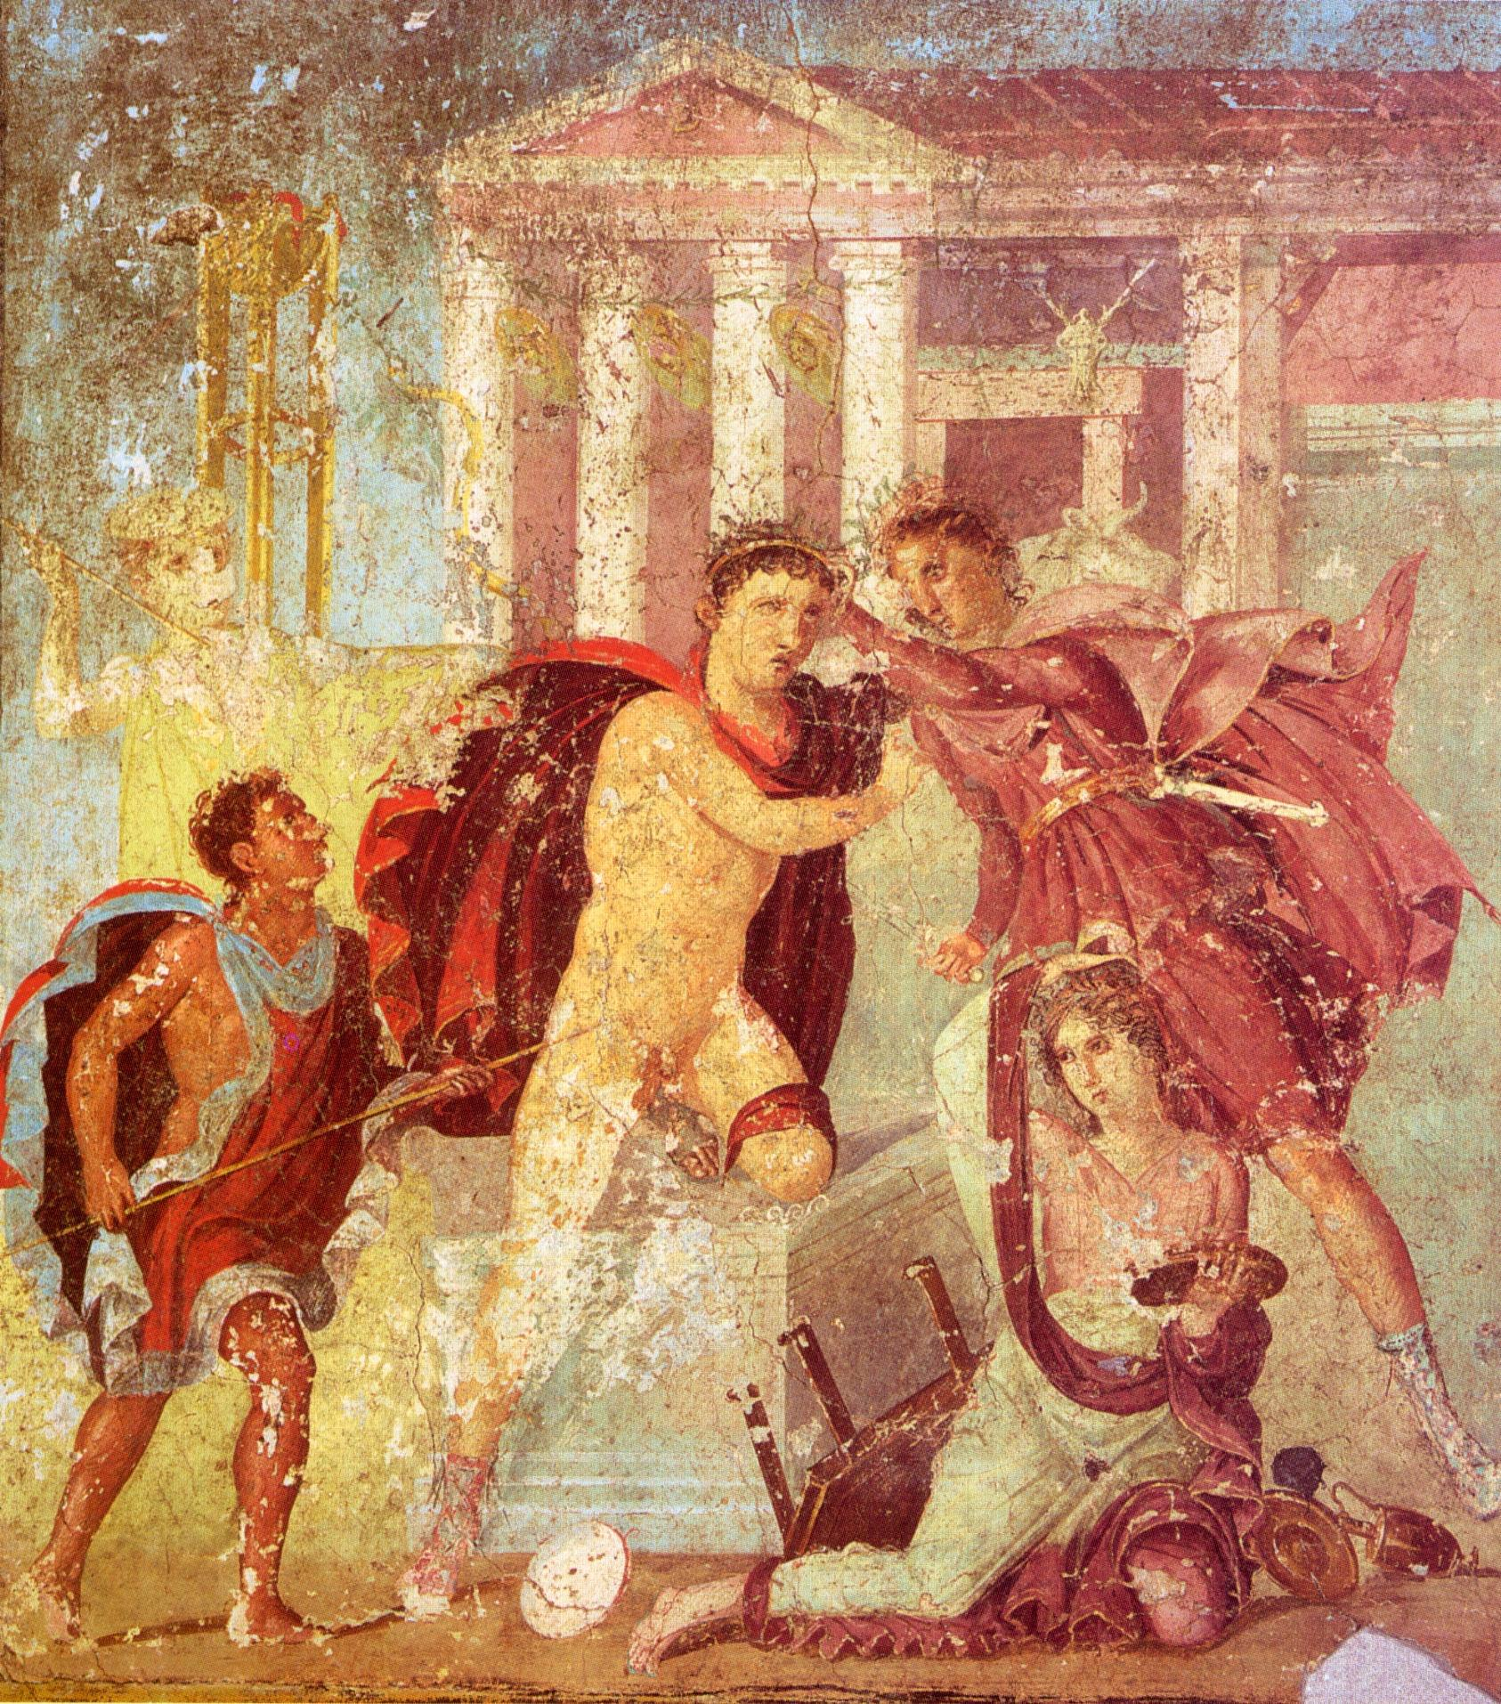
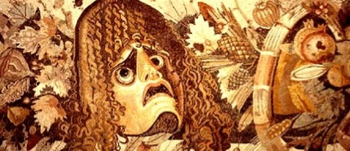
Roman Tragedy
Choral odes divide acts
Sententiae - short phrases that showed idea
Violence was showed
Tragic flaw
Character’s thoughts revealed through soliloquies

Slide 9
References
http://novaonline.nvcc.edu/eli/spd130et/roman.htm#for
http://blogs.cornellcollege.edu/cla36481213/comedy-terms/roman/
http://www.apgrd.ox.ac.uk/learning/short-guides/ancient-pantomime-and-its-reception

Slide 10
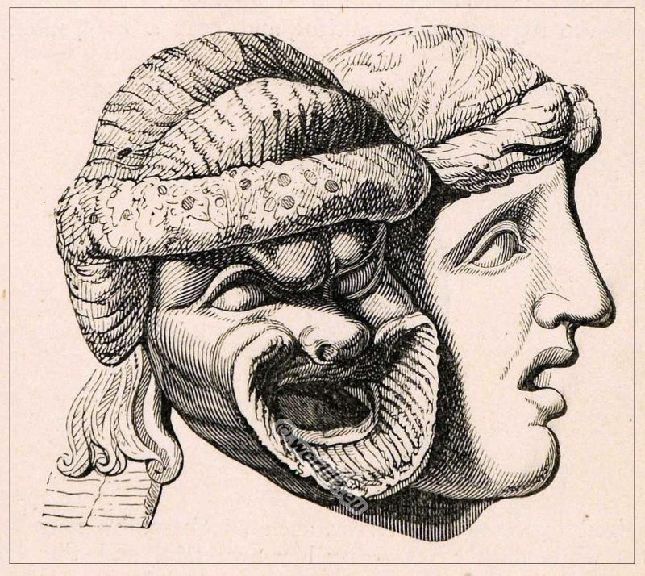
Thank You!

