Slide 1
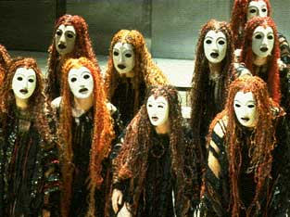
Greek Theatre
Theatre Arts

Slide 2
Origins
The earliest origins of drama are to be found in Athens where ancient hymns, called dithyrambs, were sung in honor of the god Dionysus.
His followers, formed a parade of satyrs, performed the dithyrambs in a chorus, and sacrificed a goat in honor of the god
Eventually, certain members of the chorus evolved to take special roles within the procession, but they were not yet actors
Legend has it that Thespis is the first actor. He stepped out of the chorus and spoke to them as a separate character
Origin of the name “thespian” for actors
Later playwrights added additional characters
Turned into a whole festival for Dionysus where citizens worshipped and playwrights won prizes.

Slide 3
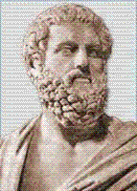
Greek Playwrights
Aeschylus (525-456 BC)
Often called the Father of Tragedy
Plays dealt with the interaction between gods and men,
with emphasis on the inevitability of suffering.
Known for his Orestia trilogy
Sophocles (496-406 BC)
Responsible for the addition of the third actor on stage
He wrote over one hundred plays
He won the City Dionysia prize 18 times
Only seven of this plays have survived
Known for Oedipus Rex
Euripedes (480-406 BC)
Youngest, most modern, and least popular of the three great writers of tragedy.
Emphasized psychological motivation and social consciousness
Appealed to the emotions by including in his plays a look at the small details of the daily lives of his characters
Aeschylus wrote about gods, Sophocles wrote about heroes, and Euripedes wrote about men.
Sophocles
(Google Images)
(“History of Theatre”)

Slide 4
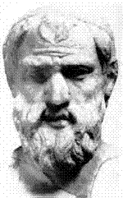
Greek Playwrights
Aristophanes (448–380 BC)
The eleven surviving plays are the only examples we have of what is called “Old Comedy”.
Wrote very funny and popular social satire
He poked fun at public figures such as Socrates and Euripedes.
He was not above having the gods come out second best in plays.
Menander (342-291 BC)
He is known for “New Comedy”.
The only surviving work of this style was written by Menander
He wrote comedies dealing with daily life and domestic situations
His plays featured characters such as clever servants, protective fathers, and young lovers—types who have been standards in the comic theatre ever since.
Aristophanes
(Google Images)
(“History of Theatre”)

Slide 5
Greek Play Structure
Prologue – characters tell audience generally what the play is going to be about (introduction)
Parados – chorus tells audience what happened before the play’s beginning
Episode – scene
Choral Ode – chorus speaks to scene
(Repeat 3 & 4 as necessary)
Final Episode – final scene
Exodus – chorus tells audience what they have learned from the story

Slide 6
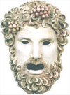
Greek Tragedy Elements
Chorus: The voice of the citizens in a tragedy. They became less important as playwrights began to use actors.
Masks: Used by actors/chorus so that many different characters could be played by one person and so that the actors’ expressions could be seen from far away
The Unities: A way of providing a central focus to a play. Aristotle believed that perfect tragedies had:
Unity of Time: The play takes place in a 24 hour time period
Unity of Place: The play has only one setting
Unity of Action: The play has one plot and no mixture of tragedy and comedy

Slide 7
Greek Tragedy Elements
An important (but understandable) person is brought down by a weakness or flaw that may or may not be his/her fault
A tragic error – a moment when the hero makes the fatal mistake that will lead to his/her downfall
Signs and omens of this fall, which the hero fails to see or only partly recognizes
Strong emotions, and the hero torn between good and evil (consciously or unconsciously)
Usually a tragic climax to the play, in which the hero comes to see his or her fault/mistake
Questions about whether people can control their own fate, or whether their lives are predetermined (already decided by the gods)

Slide 8
Types of Masks
1. OLD MEN
Smooth-Faced, White, Grizzled, Black-Haired, Flaxen and More Flaxen
2. YOUNG MEN
Common, Curled, More Curled, Graceful, Horrid, Pale and Less Pale
3. SLAVES
Leathern, Peaked-Beard, Flat Nose
4. WOMEN
Freed Old Woman, Old Domestic, Middle Aged, Leathern, Pale-Disheveled, Pale Middle Aged, Whorish-Disheveled, Virgin, Girl
5. SPECIALIST MASKS
Some made for specific characters, others for: Mourning, Blindness, Deceit, Drunkenness...etc. (The comic masks, those especially of old comedy, were as like as possible to true persons they represented, or made to appear more ridiculous)

Slide 9
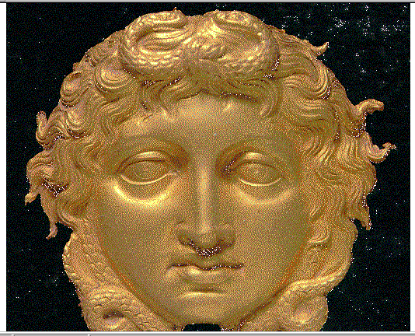
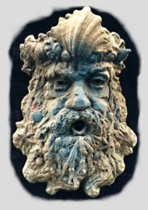
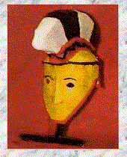
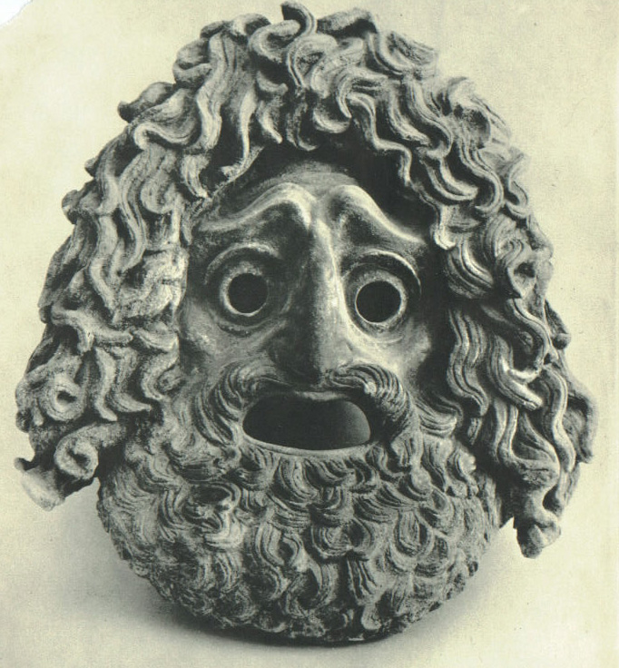
Mask Examples

Slide 10
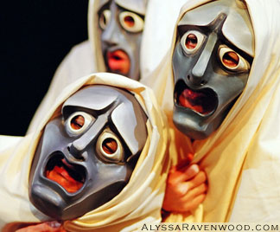
Greek Chorus Functions
First function: Narrator (tells stories, provides information)
Bridge the gap between the audience and the players and intensify emotion
Connect the audience and actors by making responses and asking questions
Maintain a sense of ceremony and ritual
Establish a lyric mood through rhythmic chanting and dance
Reinforce passions of the dramatic action
Unite music, dance and speech and connect dramatic episodes

Slide 11
Greek Chorus Functions
When the first actor stepped out of the chorus and assumed a role, the chorus was then able to assume a role as well (i.e. if the actor was playing a god, the chorus could become his worshippers)
Chorus could work within the story as characters, or from the outside as impartial commentators
Chorus could punctuate the action of a play with bursts of song and dance, which enlarged the dramatic action and relieved tension
Ideal spectator – provided commentary and questions, gave opinions and warnings, clarified experiences and feelings of characters in everyday terms. The chorus sympathized with victims, reinforced facts, separated episodes and often served as spokespeople for the conservative members of the community.

Slide 12
The Actors
The Greek name for an actor was “hypocrite.”
As there were only 3 actors, they wore masks to play multiple parts.
All actors were men, because it was considered undignified for women to appear on stage
Actors wore padded costumes, wigs, and high-heeled boots to make them taller and give them added dignity and power.
Actors had to be able to speak in poetic language and sing using a loud and clear voice.

Slide 13
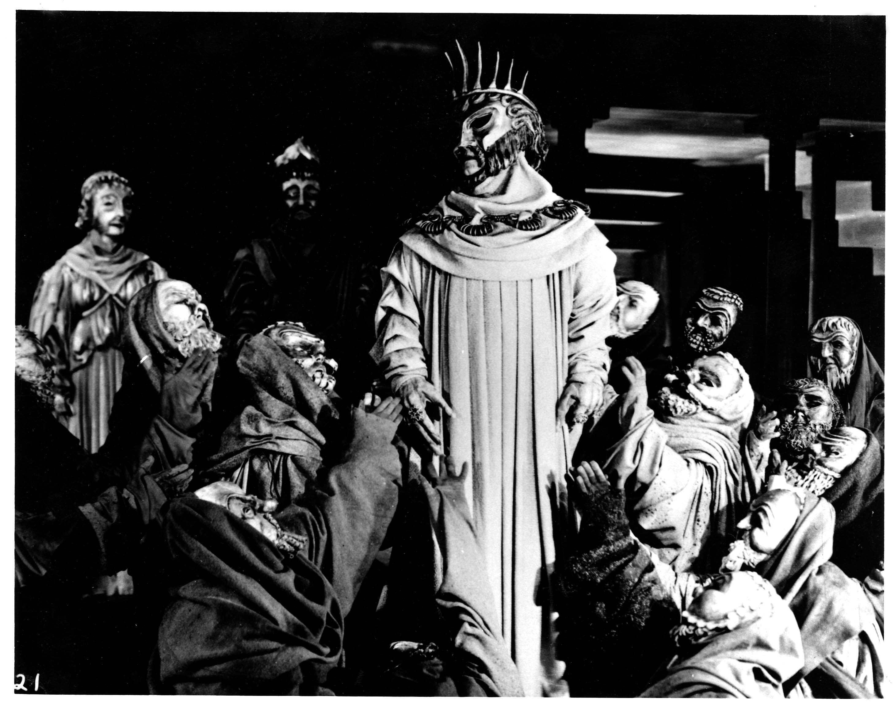
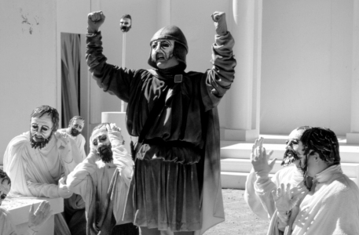
Aristotle’s Tragic Hero
Comes from nobility (royalty)
Has a tragic flaw, hamartia (caused by a simple mistake or a character flaw, like pride)
Undergoes a Reversal of Fortune (falls from high to low)
Has a downfall
Recognizes his mistakes

Slide 14
The Greek Stage
Three Main Portions of Greek Theatre:
Skene – Portion of stage where actors performed (included 1-3 doors in and out)
Orchestra – “Dancing Place” where chorus sang to the audience
Theatron – Seating for audience

Slide 15
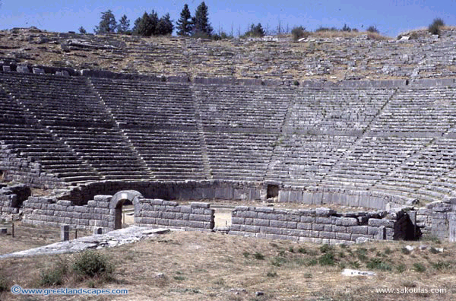
Dodoni Ancient Greek Theatre
Theatres were built into sides of hills so that they could harness the natural acoustics.

Slide 16
Greeks’ Special Effects
There were no curtains, intermissions, lights, or microphones.
Consequently, all scenes took place in daylight settings, all scene changes had to be built into the actor’s dialogue, and the chorus and actors had to have strong voices.
Deus ex machina (meaning: “god from the machine”) = type of crane used for suspending figures who portrayed gods.
Eccylema = moveable or revolving platform.

Slide 17
Theatre in Greek Society
Ancient Greek myth—the theme of most dramatic tragedies—touched the individual and the universal heart and drew the audience together, especially in times of hardship.
Because the Festival of Dionysus served as a ritual to honor the god, attending the theater was a religious duty and responsibility of all pious citizens, but women and slaves were often left out
Tragedy started at the City Dionysia, later become state sponsored
First day still honored the tradition of dithyrambs, with a procession of a large Dionysus statue and the sacrifice of pigs
Festival lasted several days, and prizes were given for best tragedy, comedy, acting, and choral singing
Three playwrights competed, each writing 3 tragedies (in a trilogy) and a satyr

Slide 18
Influence on Modern Theatre
The aim of tragedy is still mainly to provide catharsis--a purging of emotion—through the suffering and transformation of the protagonist
Examples: Shakespeare, Arthur Miller, Tennessee Williams
The use of heightened language in tragedy—even though it’s no longer in verse, many playwrights still use very stylized language
Examples: David Mamet
Theatre Structure—remnants include: the audience in a raked semicircle, area dedicated to the orchestra, and a backstage area
Special Effects—although these have been modernized, many have their roots in Greek theatre
Characters flying from above, wheeled platforms

