Slide 1
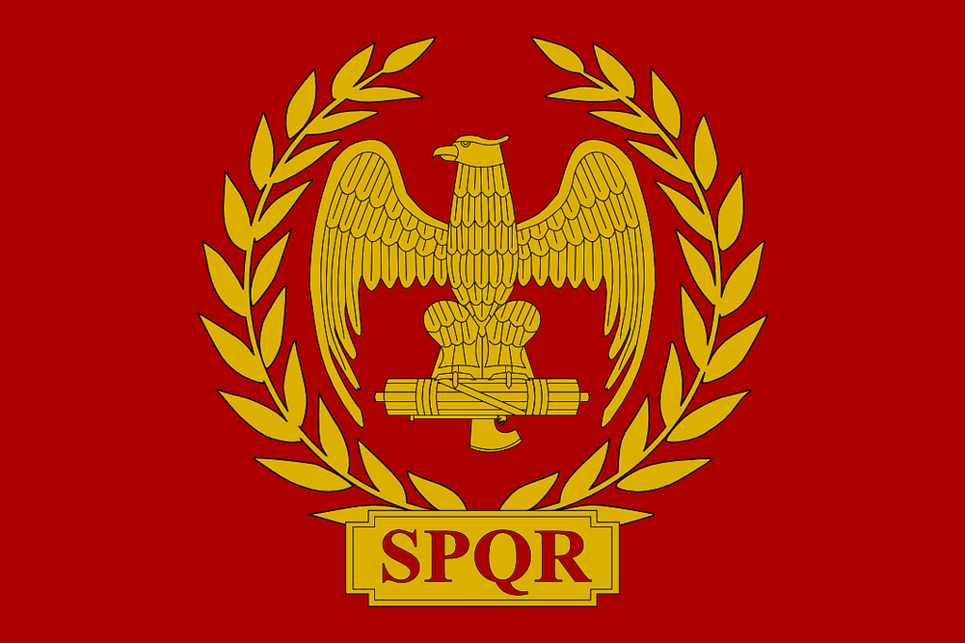
Entertainment

Slide 2
The Roman Games!!!
-The games the romans had involved tons of movement like in the races that were performed there and also other sports events.
-In most roman cities there were always scattered theaters that always had some kind of performance happening.

Slide 3
Gladiatorial contests!!!
-Gladiators did not always fight to the death in their matches.
-Gladiator performances were performed in Public places like the Colosseum were also sports related games were performed.
-Gladiators also fought animals like Lions , bears , rhinos and even elephants.

Slide 4
Chariot Races!!!
-Chariot races were colour coded with colors like red , white , blue and green.
-There were teams of 4 , 6 and 8 and 10.
- Chariot racing was also practiced in much of the Roman empire’s territory.

Slide 5
Circus Maximus!!!
-A stadium like place where the Chariot races were held at.
-The Circus Maximus is slightly similar to a track because it goes around in a circle and there is grass in the middle part of the circus.
-There is a scene in the 1959 film Ben Hur where one of the settings was in a Circus Maximus related location.

Slide 6
The Colosseum!!!
- The Roman Colosseum was also known as the Flavian Amphitheatre.
- It was usually used for gladiatorial contests, mock sea battles, re-enactments of famous battles, and dramas based on classical mythology.
- The Roman Colosseum could seat between 50,000 and 80,000 spectators.

Slide 7
Entertainment
The End

