Slide 1
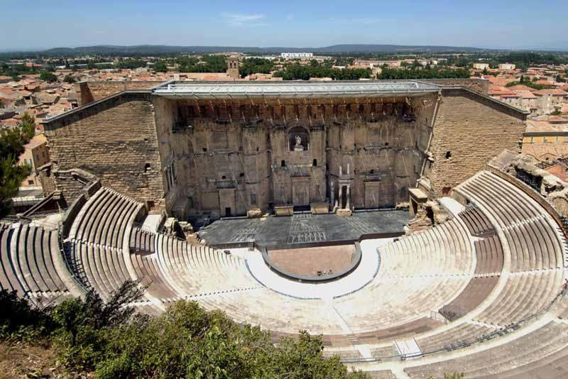
How Roman Theatre died out
& Influences on Modern Theatre
By: Julia Konovalov, Raymond Lim, and David Gewargis

Slide 2
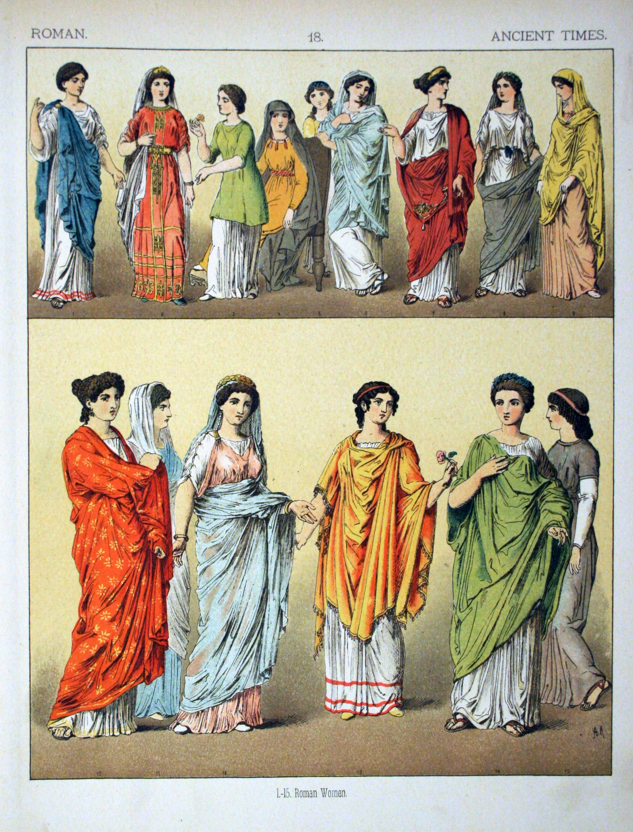
Dress Codes On Stage
A purple costume identified a rich man
Boys wore striped togas
Soldiers wore short cloaks
Red costumes indicated a poor man
A yellow robe meant the character was a woman
Short tunics indicated a slave
A yellow tassel meant the character was a god

Slide 3
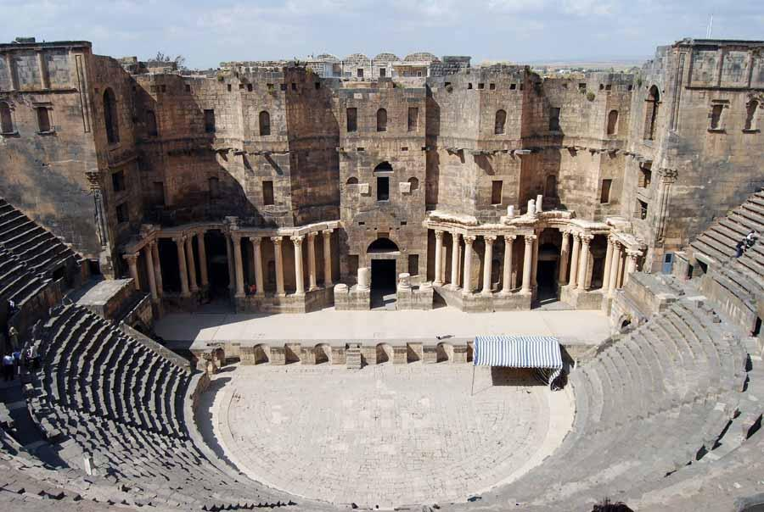
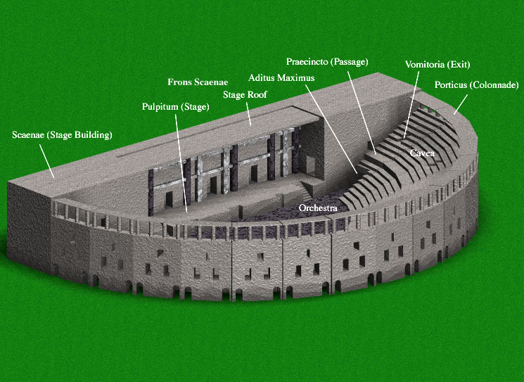
Roman Theatres and Amphitheatres
The Amphitheatres were designed for the greater spectacles and shows of gladiators and wild animals
The Circuses (circi) such as the famous Circus Maximus which was built on a much bigger scale and designed to stage chariot races
The Naumachiae where places for the shows of sea battles
The Xysti were places constructed like porticos in which the wrestlers exercised
The Odeon was a small Roman Theatre, was used for music, poetry, readings, etc

Slide 4
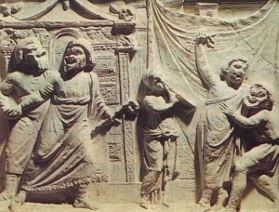
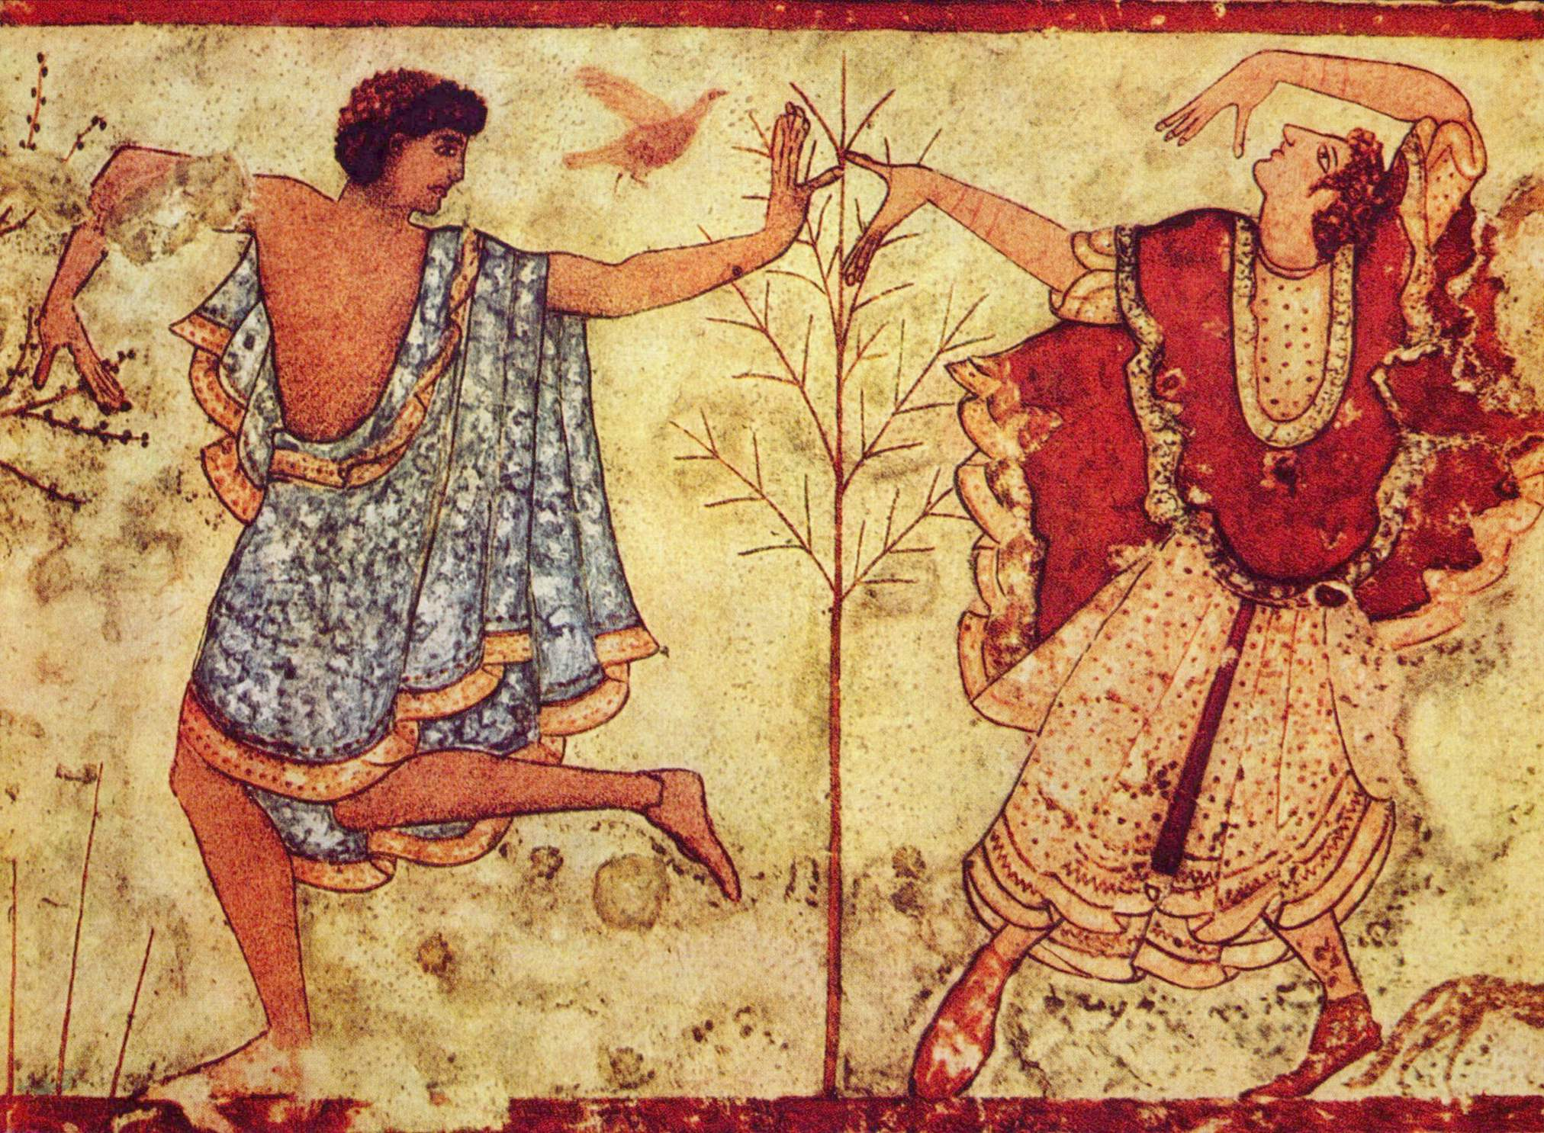
How It Influenced Modern Theatre
Greek Drama
Etruscan influences – emphasized circus-like elements
Fabula Atellana – Atellan farces (Atella was near Naples)
Comedies today display same plots and types of humor as Romans did in Ancient times
A lot more of our theatre comes from the greeks

Slide 5
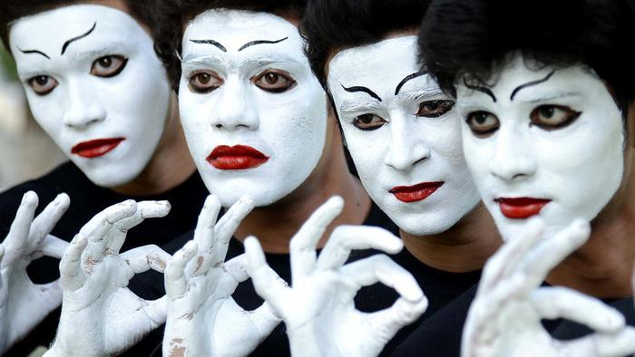
How Roman Theatre died out
The fall of the Roman Empire occurred
By 400 AD many festivals stopped
Pope Gregory made the church central to their lives
Theatre was removed as a necessity and all theatres were converted to barracks or government store­ houses
The church did not look fondly the usage of mimes in the plays
Church’s opposition to mimes:
association with pagan gods
Licentiousness (lacking legal or moral restraints)
ridicule of church by mimes (sacrament and baptism)

Slide 6
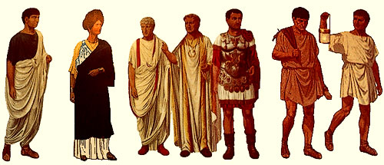
Fun Facts
Roman dramas had two sets of actors
There was an actor who spoke the character's lines and a different actor mimed the part on stage
Simple costumes were worn to allow the audience to distinguish between different characters.
Roman drama had never been more than a plagiarism of greek tragedy and comedy
No early Roman tragedies were said to survive

Slide 7
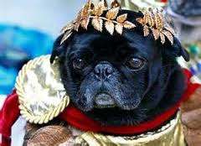
Fin.

